Slide 1
Introduction to Android Automotive OS (AAOS) & Advanced Driver Assistance Systems (ADAS)

Slide 2

Agenda
01
Overview of Android Automotive OS
02
Introduction to ADAS in AAOS
03
AAOS Architecture & How it Supports ADAS

Slide 3

01 – Overview of Android Automotive OS

Slide 4
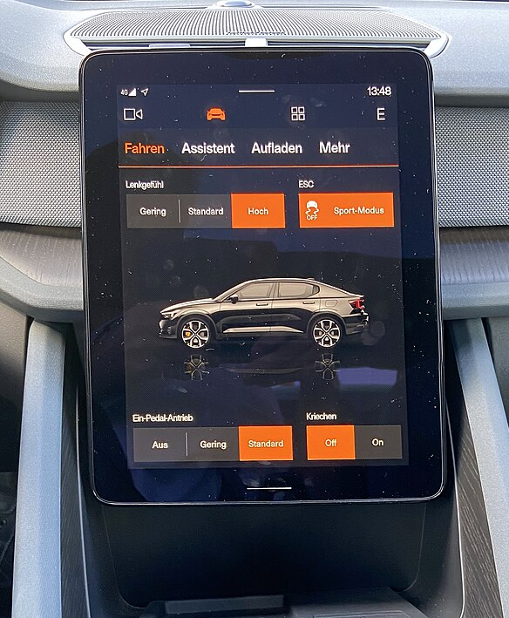
Overview of Android Automotive OS
Heads Up Display
Overview
Definition: A full-fledged operating system built on Android Open Source Project (AOSP) designed specifically to power in-vehicle infotainment systems.
Importance: Android Automotive OS offers a customizable, open-source platform for car manufacturers to develop next-generation in-vehicle experiences
Familiar User Experience
Integration with Vehicle Systems
Scalable Platform
Notes:
Open-source platform: Car manufacturers can leverage the core Android functionalities while customizing the user interface and integrating car-specific features.
Familiar user experience: Drivers familiar with Android devices can easily navigate the AAOS interface, reducing distraction and improving usability.
Integration with vehicle systems: AAOS can access and control vehicle functions like climate control, navigation, and audio systems, providing a centralized hub for car operations.
Scalable platform: The open-source nature allows for continuous development and integration of new features and technologies like ADAS (Advanced Driver-Assistance Systems).
Additional Notes:
AAOS is distinct from Android Auto, which requires a smartphone connection to project the phone's interface onto the car's display. AAOS is a standalone system built directly into the vehicle.
Discussion Points:
How will car manufacturers balance customization with a standardized user experience for AAOS?
What are the potential challenges of integrating legacy car systems with AAOS?
How can developers create safe and responsible applications for the in-vehicle environment?
References:
Android Automotive OS: https://source.android.com/docs/automotive

Slide 5
02 – Introduction to ADAS in AAOS

Slide 6
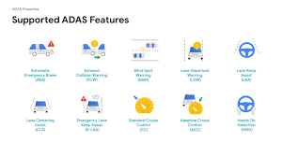
Introduction to ADAS in AAOS
ADAS Features
Overview
Definition: A collection of technologies within a vehicle that provide electronic driver assistance for safety and improved driving experience.
Importance: The integration of ADAS with AAOS creates a powerful platform for innovation in safer and smarter vehicles
Real-Time Information & Intervention
Improved Safety Features
Reduced Driver Workload
Notes:
Real-time information and intervention: ADAS systems can provide drivers with crucial information about their surroundings, such as lane departure warnings, blind spot detection, and forward-collision alerts. AAOS can seamlessly display these warnings and integrate with ADAS for automated actions like braking or steering adjustments.
Improved safety features: ADAS features like automatic emergency braking, adaptive cruise control, and night vision can significantly reduce the risk of accidents. AAOS can serve as a central hub for managing and monitoring these safety systems.
Reduced driver workload: By automating certain tasks and providing real-time assistance, ADAS integrated with AAOS can help reduce driver fatigue and improve overall driving experience.
Additional Notes:
The level of ADAS functionality can vary depending on the car manufacturer and model.
Safe and responsible implementation of ADAS is crucial to ensure it enhances rather than hinders the driving experience.
Discussion Points:
How can AAOS ensure clear and intuitive communication of ADAS information to drivers?
What are the ethical considerations surrounding driver reliance on ADAS features?
How can the future development of ADAS within AAOS balance automation with driver control?
References:
ADAS vehicle properties: https://source.android.com/docs/automotive/vhal/adas-properties
Android Automotive OS: https://source.android.com/docs/automotive

Slide 7
03 – AAOS Architecture & How it Supports ADAS

Slide 8
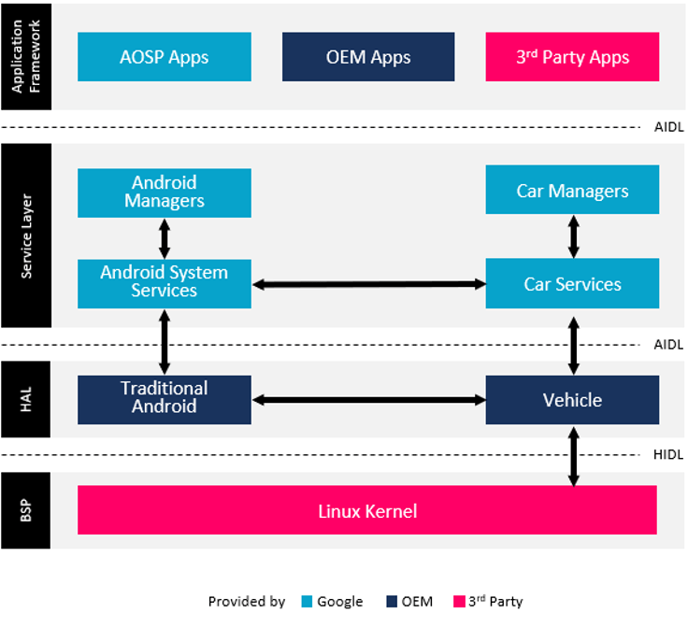
AAOS Architecture & How it Supports ADAS
AAOS Architecture
Overview
Definition: The underlying structure of AAOS defining how different components interact to deliver functionalities
Importance: A well-defined architecture is crucial for AAOS to effectively support ADAS
Modular Design
Vehicle Hardware Abstraction Layer (VHAL)
Car Property Manager
Notes:
Modular Design: AAOS utilizes a modular architecture with well-defined layers for functionalities like system services, hardware abstraction, and application framework. This allows for independent development and integration of ADAS features.
Vehicle Hardware Abstraction Layer (VHAL): This layer acts as a bridge between the core AAOS system and the car's specific hardware, including ADAS sensors and actuators. VHAL translates generic commands from AAOS into hardware-specific instructions for features like automatic emergency braking or lane departure warnings.
Car Property Manager: This component manages the exchange of data between ADAS features and AAOS applications. It provides a standardized interface for accessing information from ADAS sensors and allows applications to display warnings or initiate actions based on that data.
How AAOS Architecture Supports ADAS:
Secure and Reliable Communication: The modular architecture ensures data exchange between ADAS and AAOS happens through defined interfaces, promoting system stability and security.
Integration of Diverse Features: The modular design allows for the integration of various ADAS functionalities from different vendors without needing to modify the core AAOS system.
Scalability for Future Technologies: The architecture is designed to accommodate future advancements in ADAS and connected car technologies, enabling seamless integration of new features.
Additional Notes:
The specific implementation of the AAOS architecture and its support for ADAS can vary depending on the car manufacturer.
Security and privacy considerations are paramount when handling ADAS data within the AAOS architecture.
Discussion Points:
How can the AAOS architecture be further optimized for real-time communication critical for ADAS features?
What are the challenges of ensuring cybersecurity within the ADAS data exchange framework of AAOS?
How can the future development of the AAOS architecture balance the need for modularity with efficient data processing for ADAS applications?
References:
Android Automotive OS Architecture: https://source.android.com/docs/automotive
ADAS vehicle properties: https://source.android.com/docs/automotive/vhal/adas-properties

Slide 9
Thank You!

